Slide 1
Conditioning a Recurrent Neural Network to synthesize musical instrument transients
Lonce Wyse, Muhammad Huzaifah
National University of Singapore
Notes:
What about pitch and instrument?
Though not the focus of this work, we note that the units track the period of the pitch. No frequency selectivity was observed unlike volume. (show figure)
For instrument the waveforms of the units are modified slightly.

Slide 2
Objectives
Model transient properties
Visualize hidden units of RNN
Train an RNN to predict sound samples augmented by control parameters for pitch, volume, and instrument ID
Notes:
Intro –
Model predicts the next audio sample based on the current sample and conditional parameters
Conditional parameters are used to direct and control the audio output
In this particular model we define volume, pitch and instrument as these control parameters.
Volume as a proxy for breath pressure in wind instruments, pitch spanning 1 octave, 2 instruments with different harmonic structure
Following up from previous work, we set out to do 2 things: model transient properties, and visualize hidden units of the RNN

Slide 3
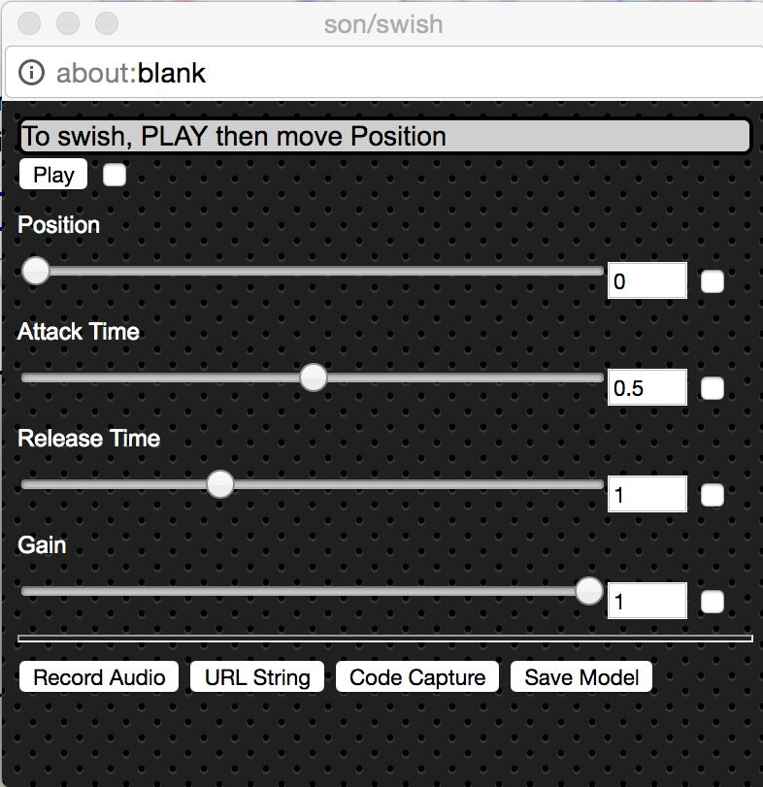
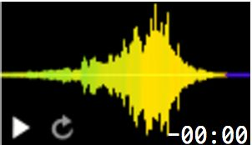
Objective: Data-driven sound modeling
Provide sound examples and desired interaction
Get parameterized synthesis model
Lyrebird.ai – train on your voice,
Type text to synthesize
Notes:
https://lyrebird.ai

Slide 4
RNN Architecture
y₁
One-hot, 256
GRU
GRU
4 layers, 40 units each
GRU
GRU
Wyse, L. (2018) Real-valued parametric condition of an RNN for interactive sound synthesis. In Proceedings of the Proceedings of the 6th International Workshop on Musical Metacreation, ACM Conference on Computational Creativity. Salamanca, Spain, June, 2018.
Mu-law, real in [0,1]
x₁
pitch
volume
real in [0,1]
instrument
Notes:
Input layer?
Output layer?

Slide 5
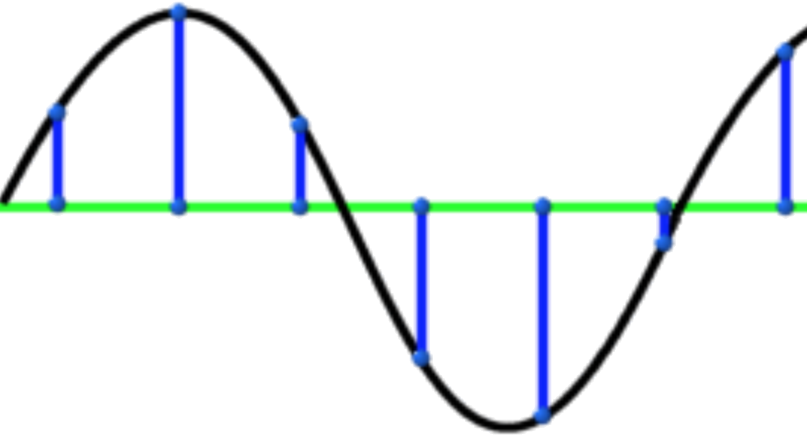
RNN Synthesis
y₁
y₂
y₃
y₄
y₅
y₆
p₁
x₁
p₂
x₂
p₃
x₃
p₄
x₄
p₅
x₅
p₆
x₆
Control Parameter input

Slide 6
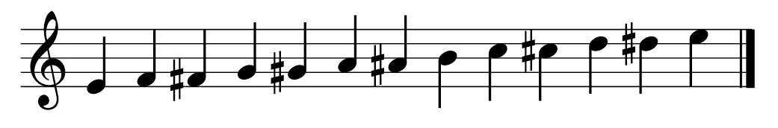
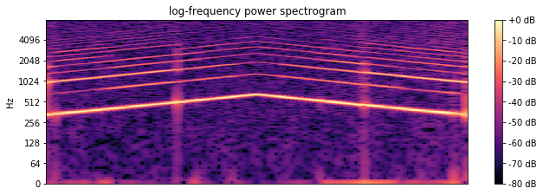
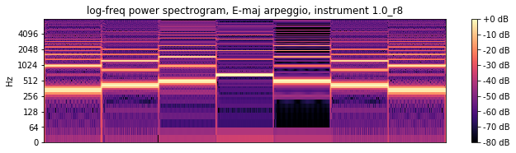

Training on steady-state pitches
Generalization
(synthesize between chromatic pitches)
Responsive
(unseen sequences)
Notes:
No drift with conditional input

Slide 7
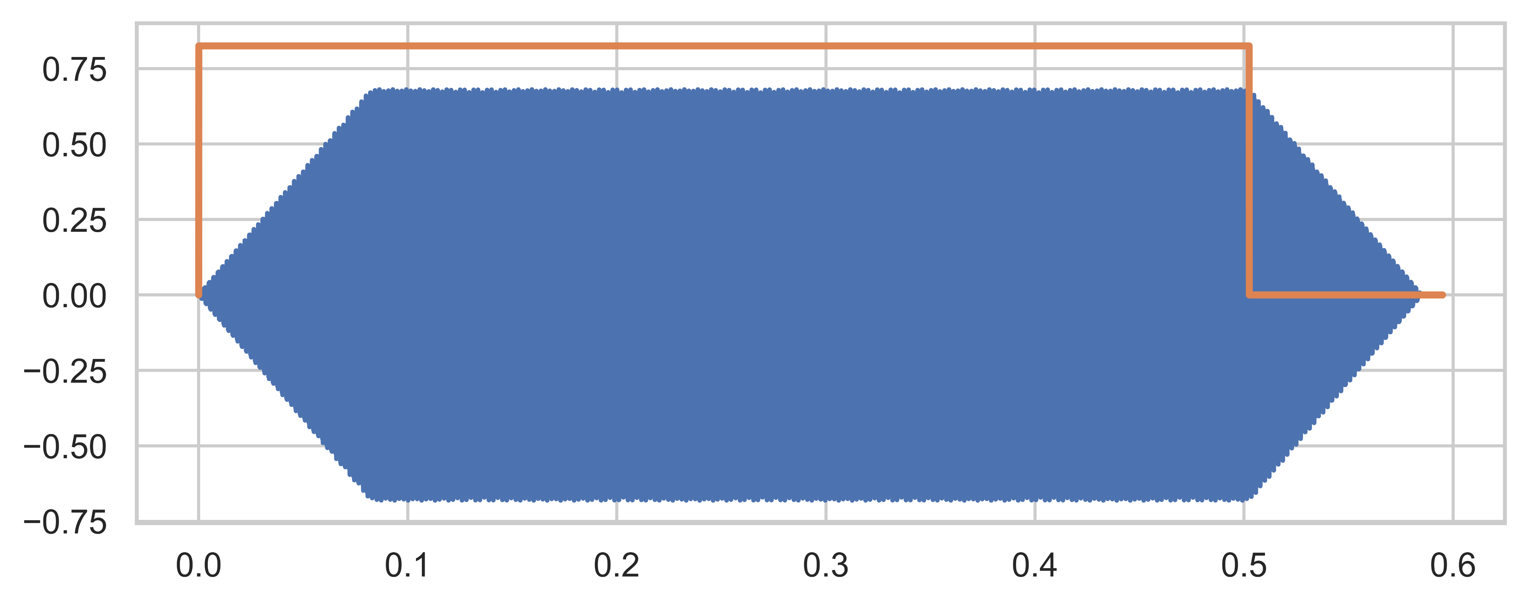
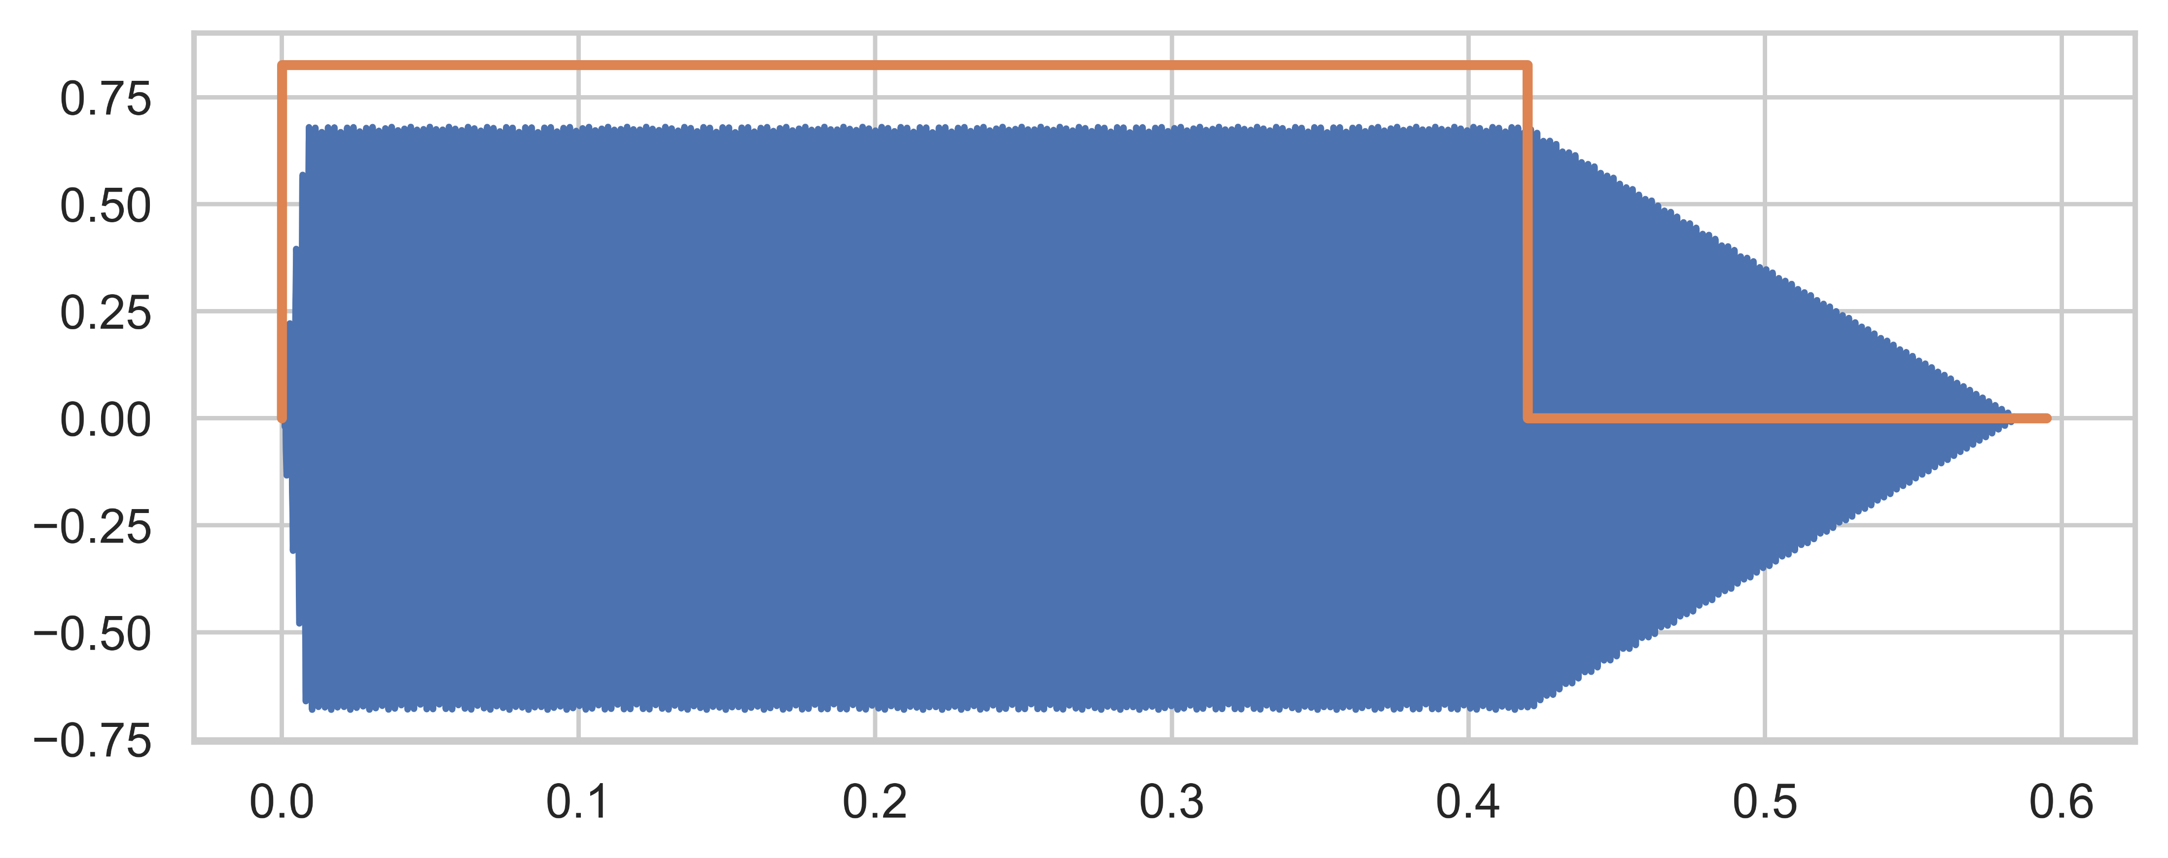
What are transients?
SynthEven
Waveform between input / cessation of energy and steady-state
Attack
Decay
Together with steady-state portion forms the sound envelope, an important element of timbre
SynthOdd
Notes:
Transients can be fairly complex, made up of high amplitude non-periodic waveforms in real instruments
(show training data, explain through examples)
Transients consist of an attack and decay
<Explain differences in syntheven and synthodd>
It is an important audio property since it is a big element of what characterises a sound in terms of its timbre

Slide 8
What distinguishes transients?
SynthEven
Implicit – Not directly controlled by a parameter but is a response to a change in (volume) parameter
Parameter disconnect – Non-instantaneous response to control parameter
Time evolution – Forms over time
SynthOdd
Notes:
Transients have been somewhat overlooked (or not the focus) of previous learning models using deep learning
But they are interesting from a modelling perspective because of....

Slide 9
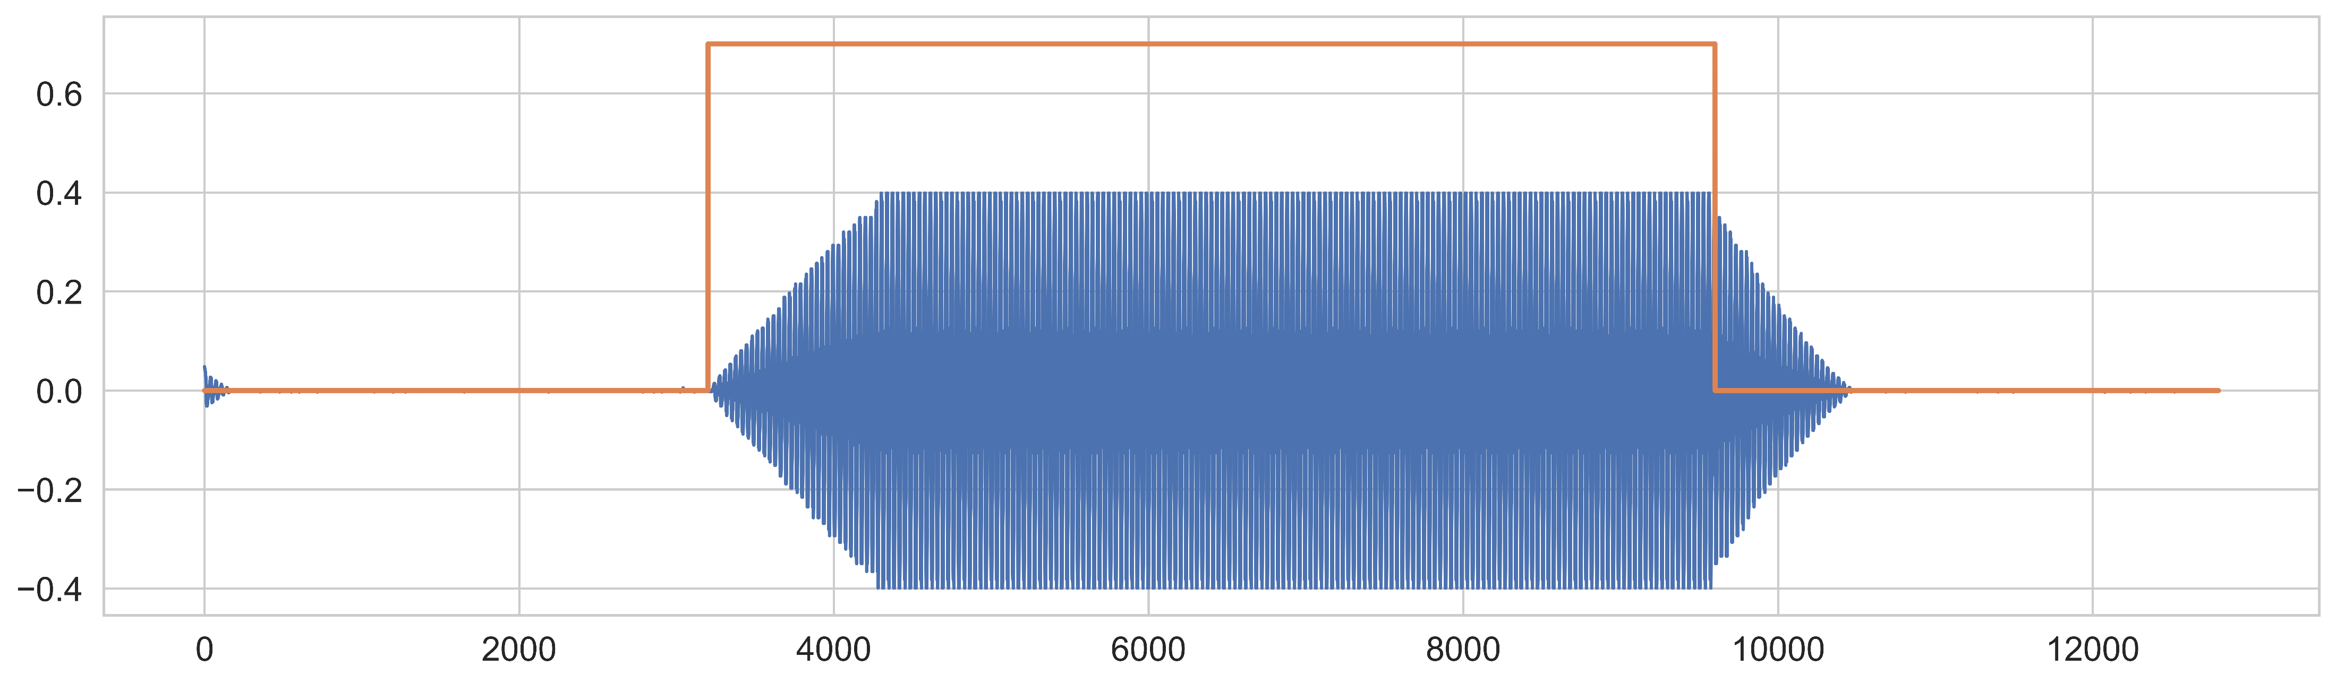
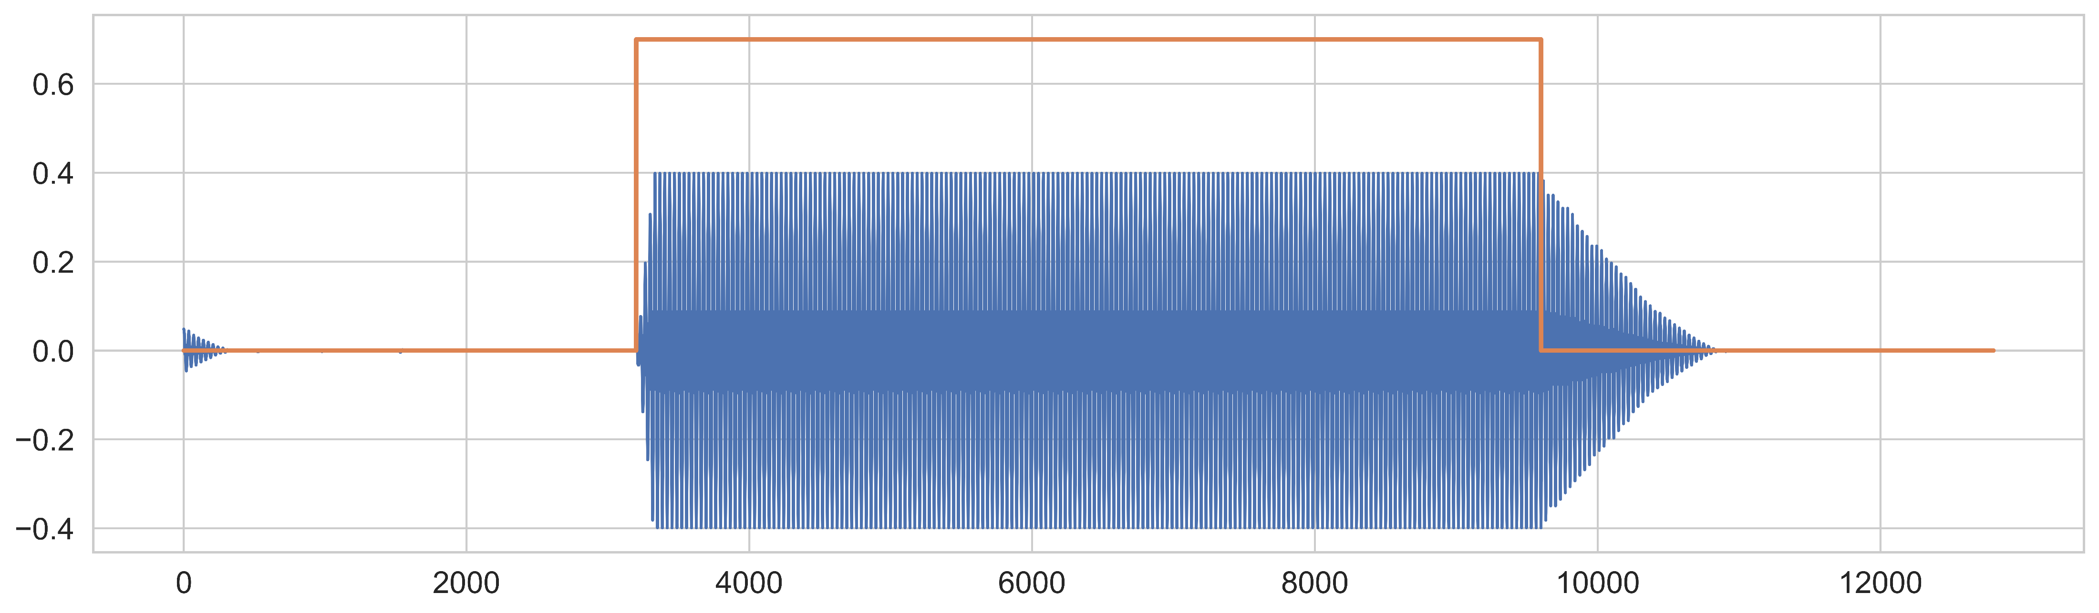
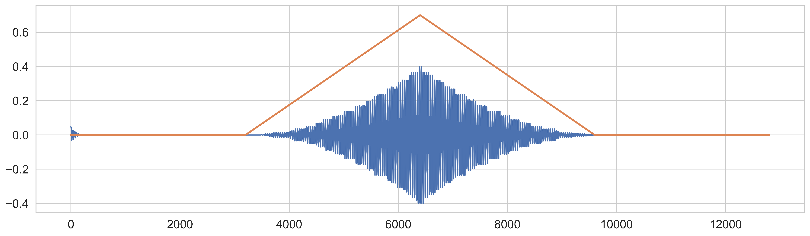
Synthesis results
Notes:
Here are some of the synthesis results showing the output of our model
Specifically we show he that the model responds to the onset of the volume parameter (orange line) -> transient forms
Also behave as expected for pitch and instrument.
Whereas the system works in principle in responding to control parameters and interpolation, it is not fully robust against all parameter combinations.
Some parameter values fail to generate a signal. For example at the extremes of 0.5 for instrument.

Slide 10
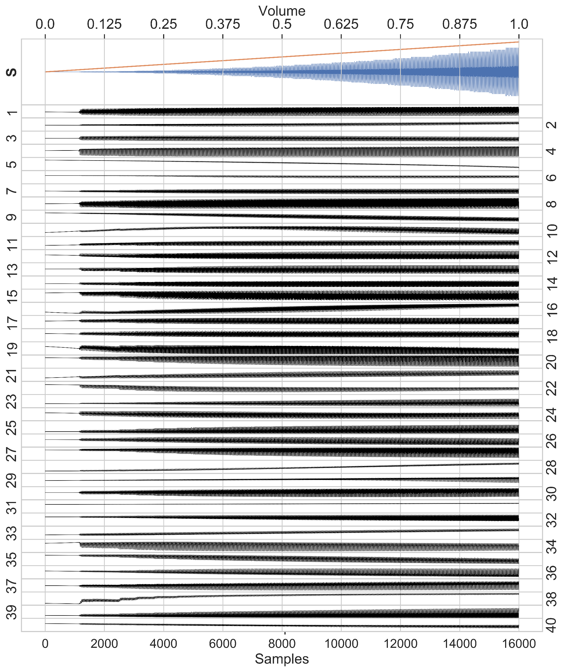
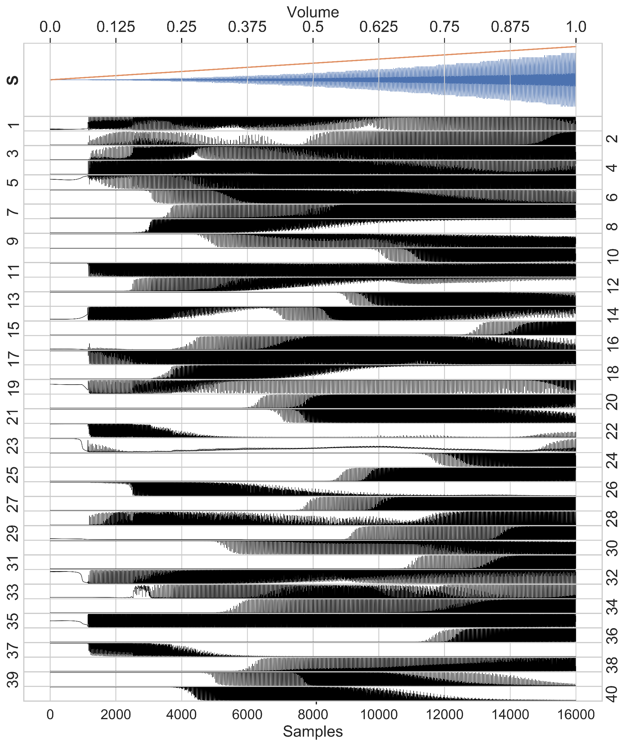
Hidden layer patterns – volume sweep
Layer 1
All units oscillate at frequency of the pitch, but with different waveforms.
Volume selectivity observed in deep layers
Each unit differentiates itself from other units with a more unique response curve
Volume is encoded by signal complexity
There are large overlaps in certain regions
Layer 4
Notes:
1) Almost all units oscilate at the frequency of the pitch
Visualize the activation values of the hidden units in each layer of the RNN as a response to changing volume.
Layer 1 mostly tracks the volume parameter directly, the amplitudes correlate with the volume – volume increase amplitudes gets bigger
The deeper layers units show greater differentiation from other units with a more unique response curve - (‘specialization’).
Layer 4 shows volume selectivity for different units
Not only that but the signal complexity also encodes the volume. -> seen in the black vs grey portions -> will elaborate later
There large overlaps in certain regions (‘redundancy’?)

Slide 11
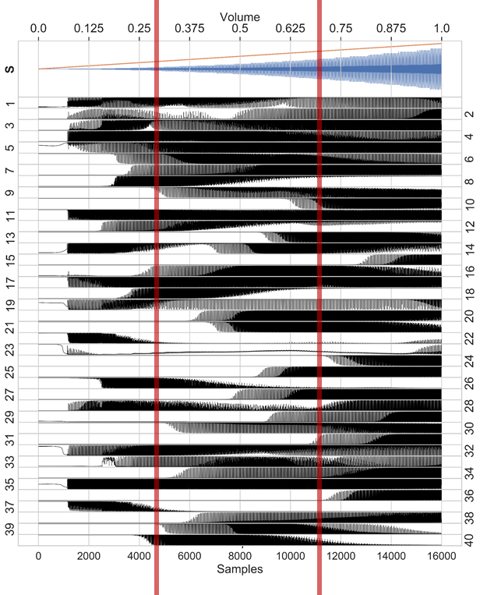
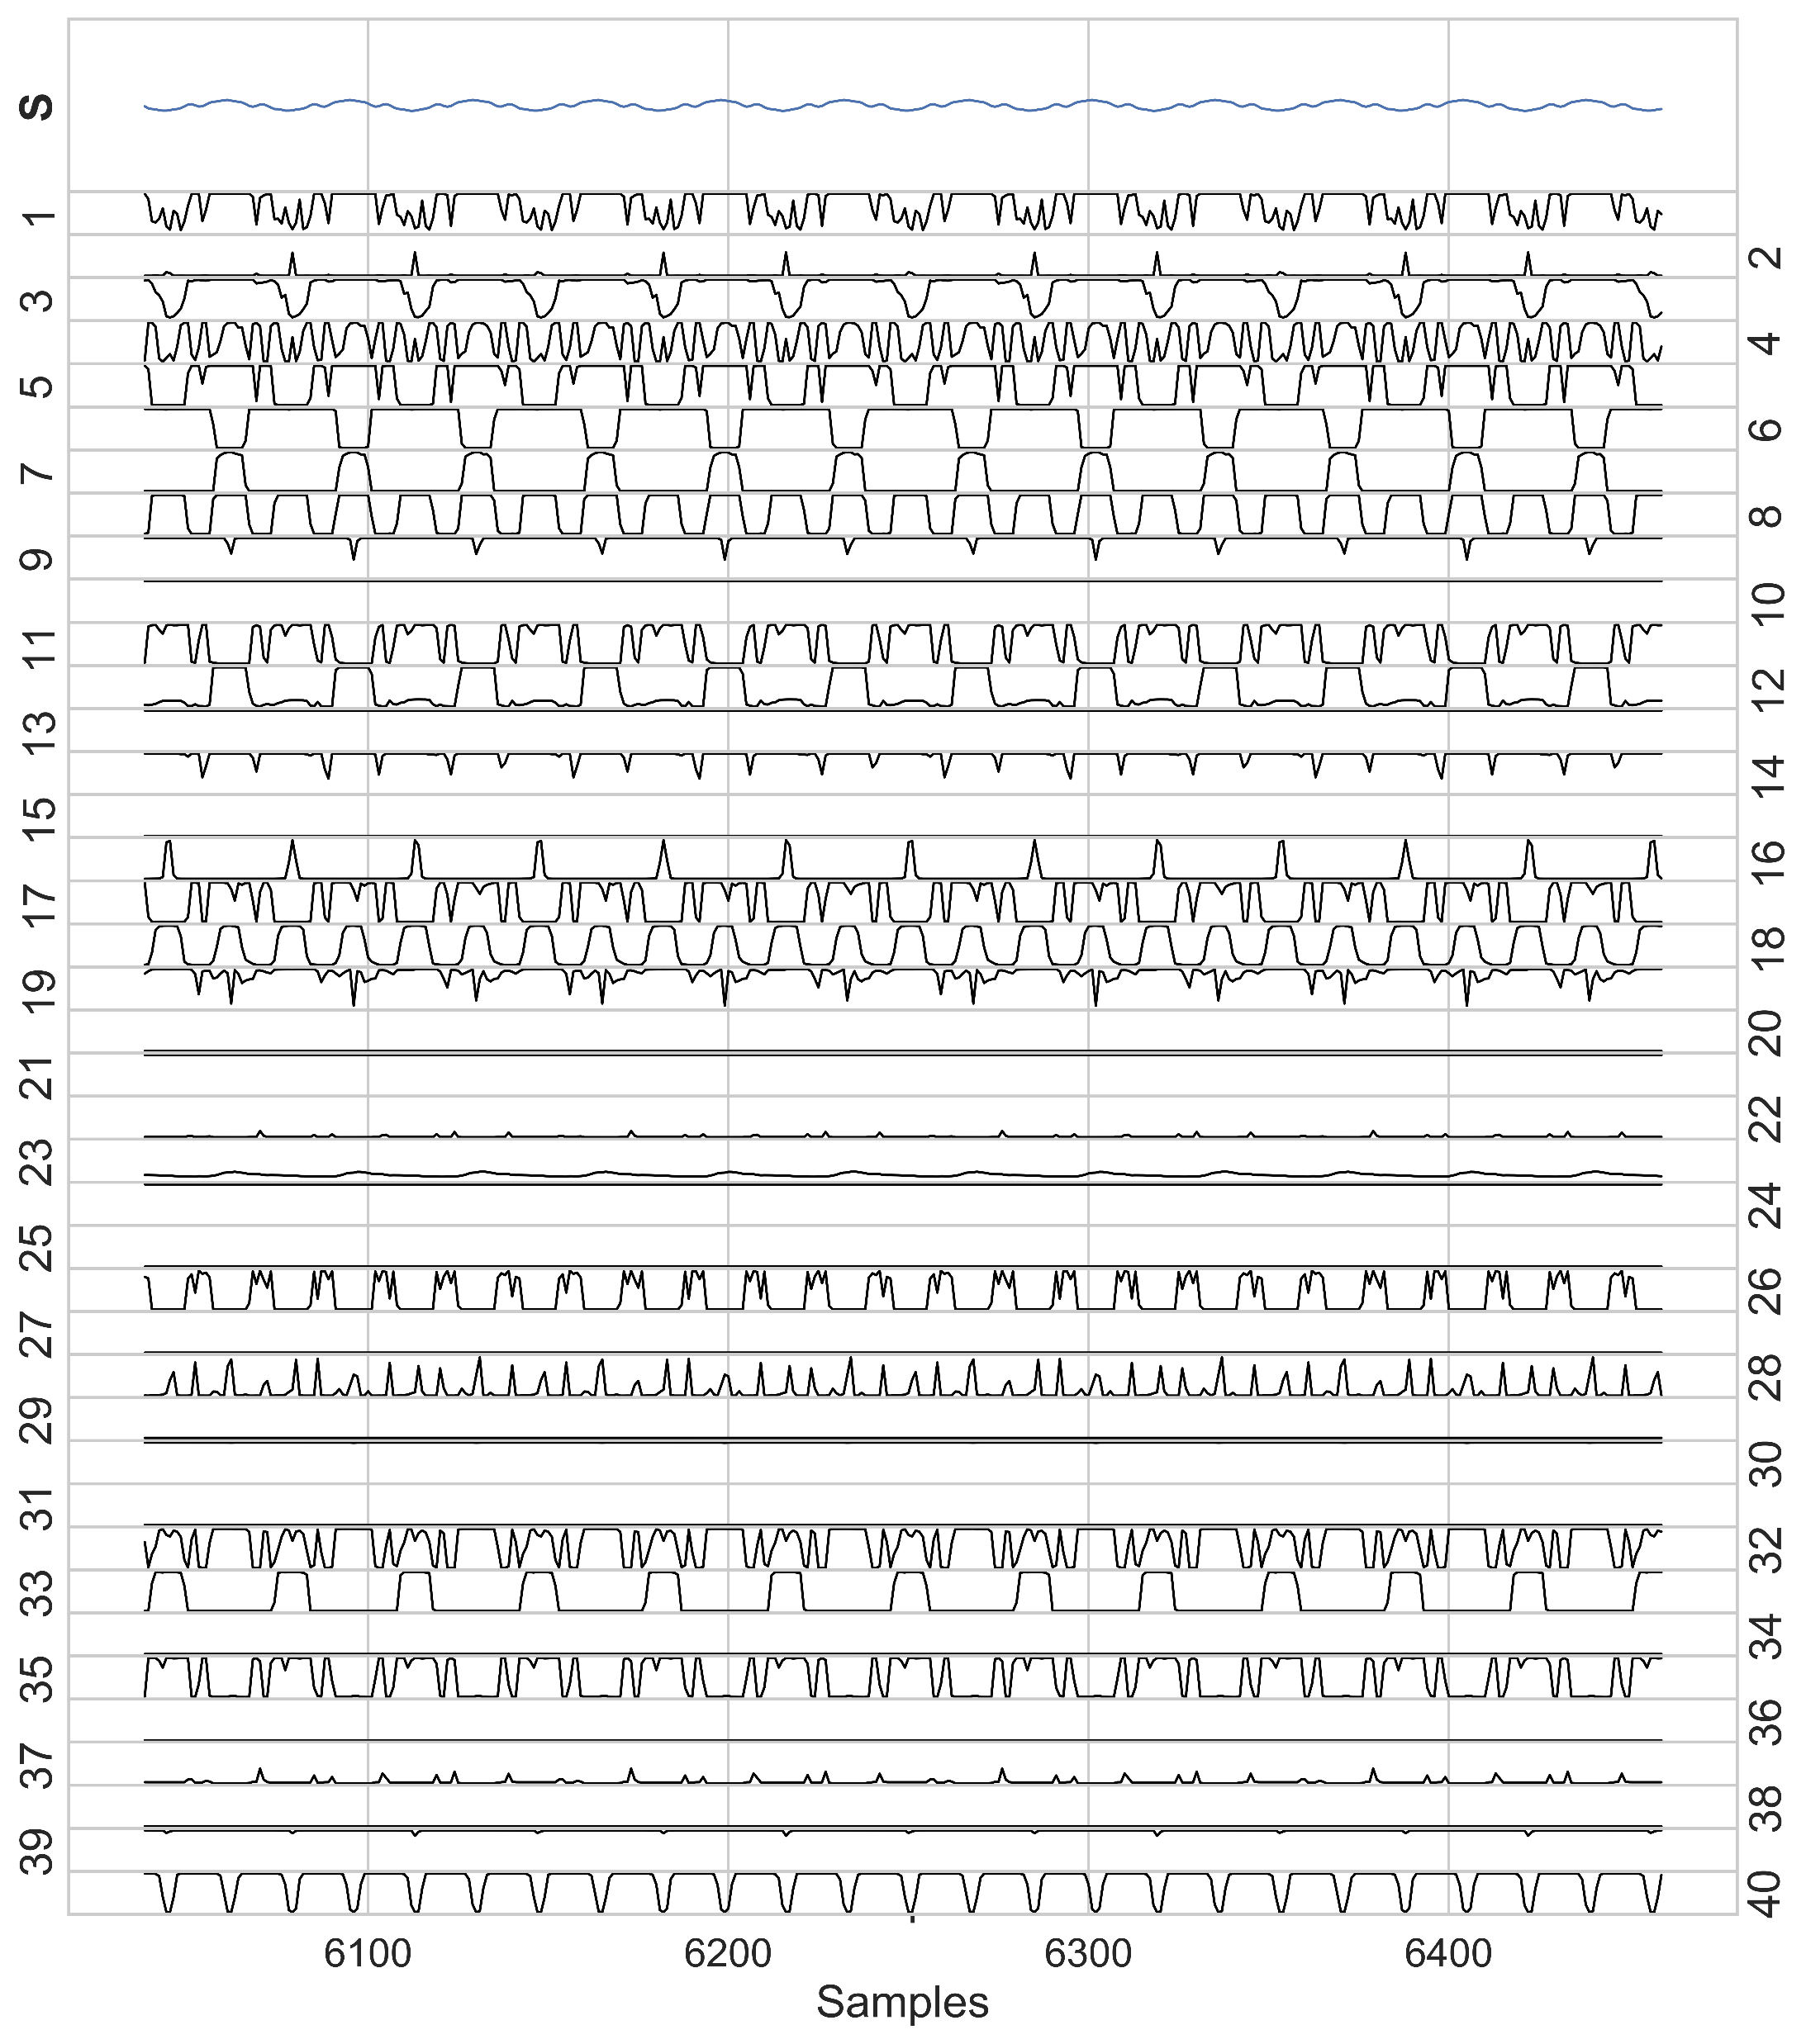
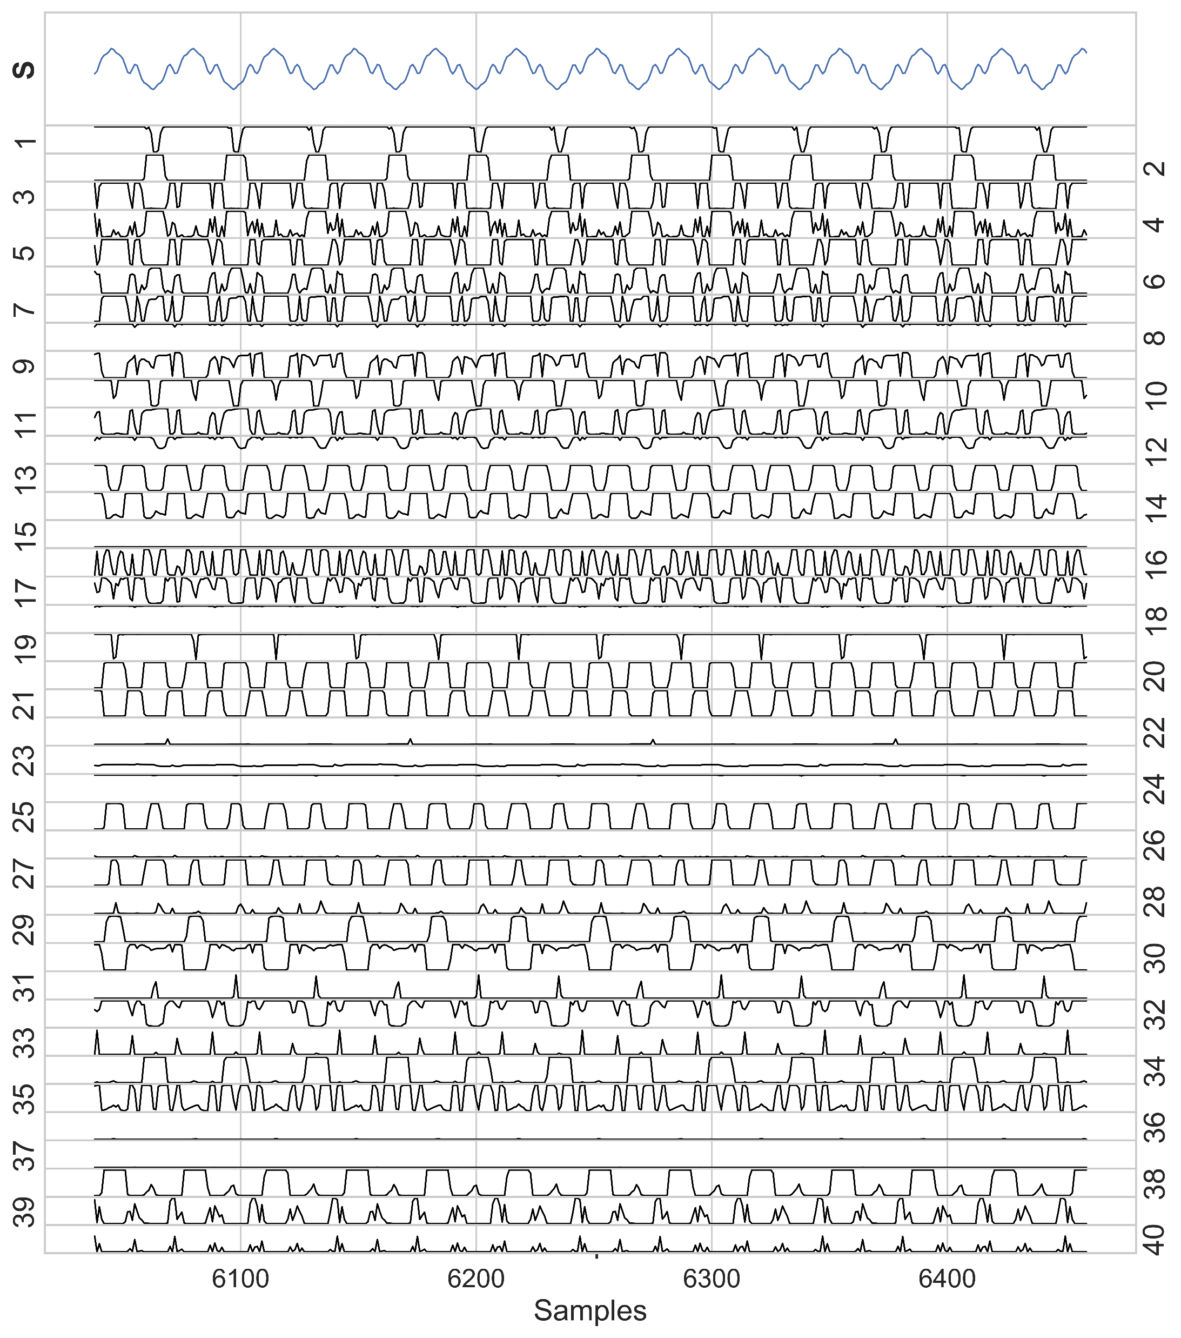
Hidden layer patterns - zoomed
Volume = 0.3
Volume = 0.7
Notes:
If we take two points at different volume level and zoom in (show the number of samples) then you’ll get the figures here.
Each unit oscillate with an individual characteristic waveform
Take the example of unit 10,39 and 40.
Unit 10: shows activity at 0.7 but flat at 0.3
Unit 39 & 40: similar response curve at mid range, 39 activates at slightly higher volumes and has a wider range of sensitivity than 40
40 is oscillating at 0.3 while 39 is flat, both are responding at 0.7 but 39 has a greater amplitude and more complex

Slide 12
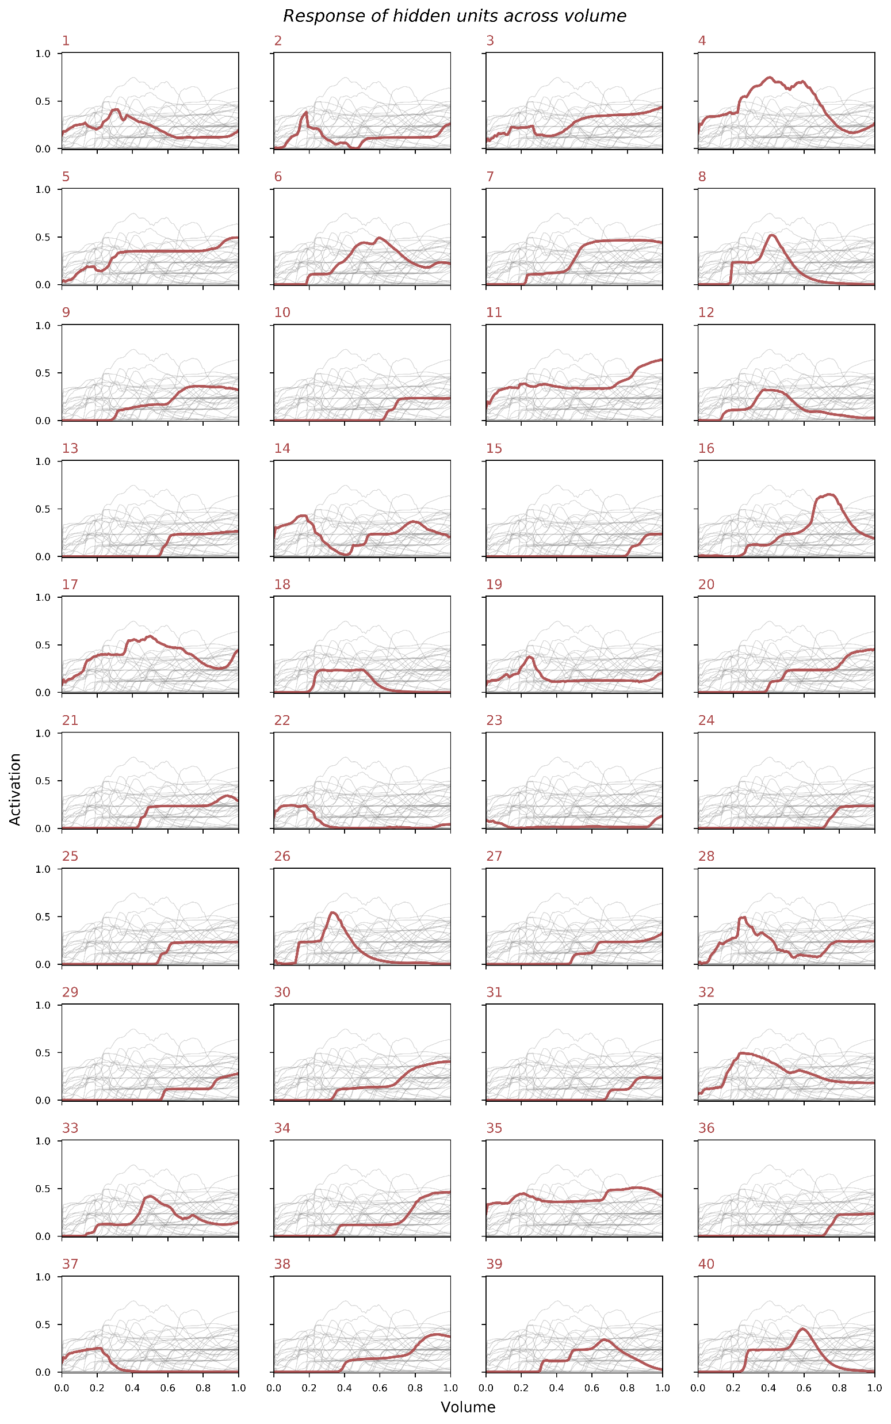

Hidden unit response across volume
Complexity =
Majority units activate at high and mid range
Bimodal, low end response also present
Notes:
The further characterize the complexity of the hidden unit signal, we quantify using the equation (explain eq)
<Explain the algo simply>
Each unit has a characteristic response curve – about half respond at high volumes, significant number at mid range
Some special cases – bimodal (14,23), low end (22,37)

Slide 13
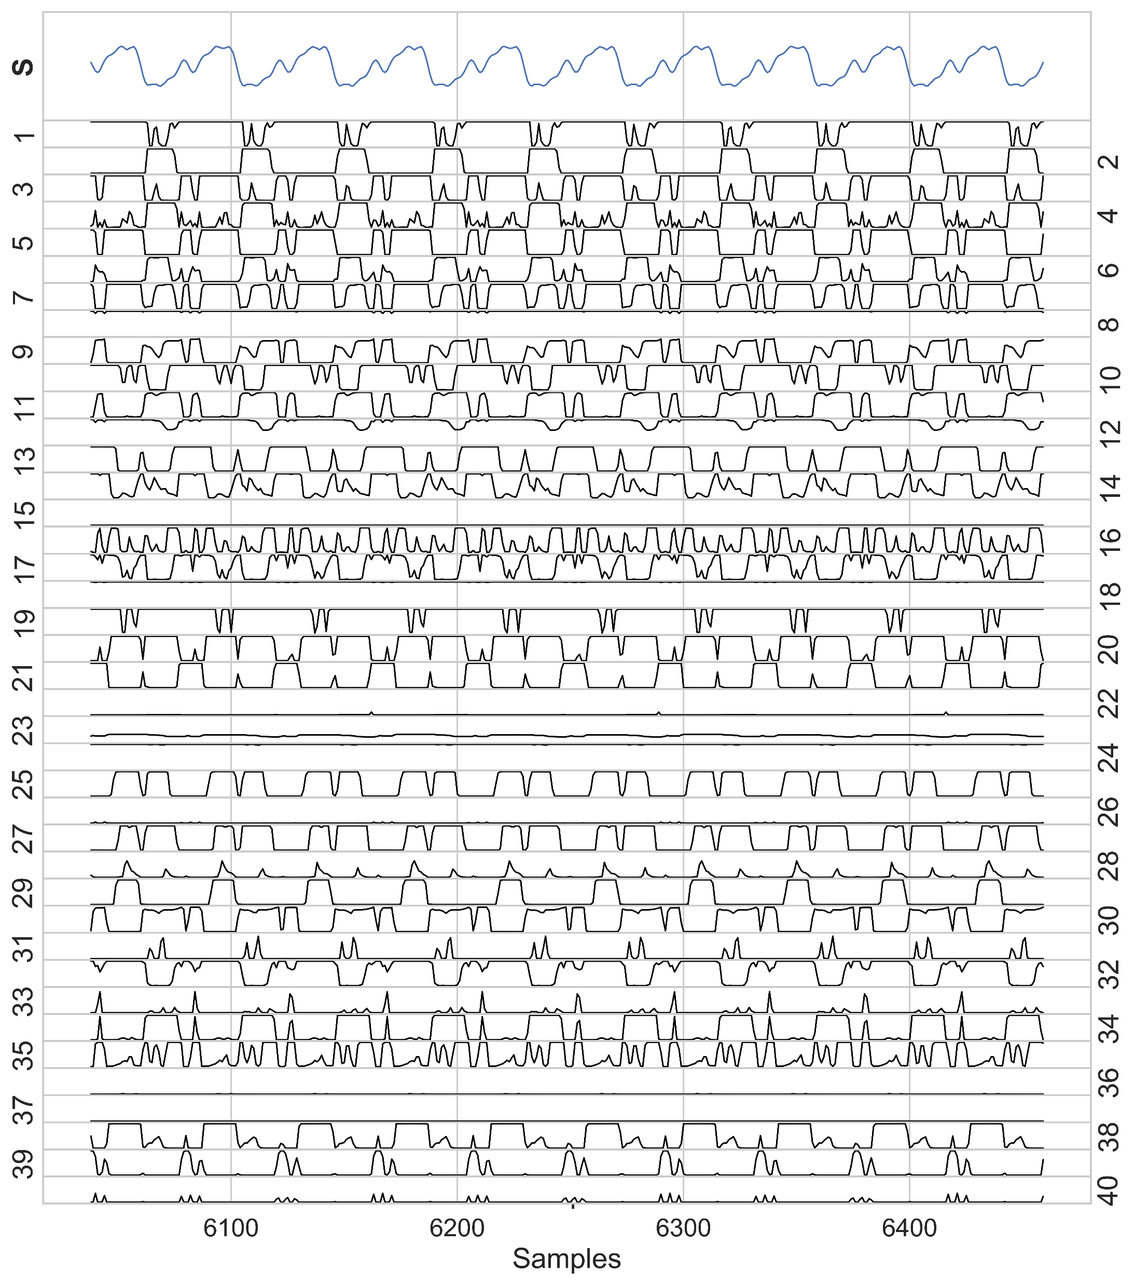
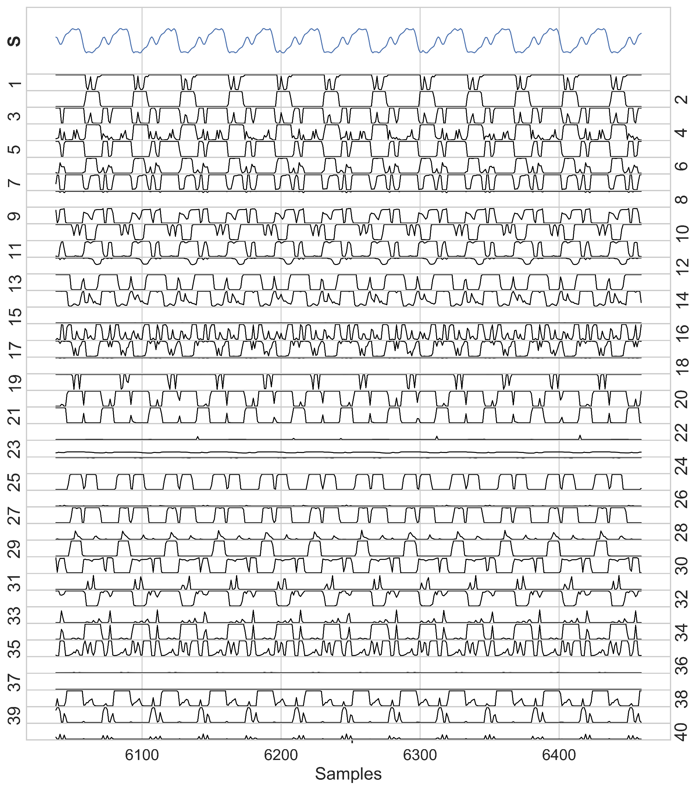
Pitch response
Units track period of pitch
Pitch = 0.2
Pitch = 0.5
Notes:
What about pitch and instrument?
Though not the focus of this work, we note that the units track the period of the pitch. No frequency selectivity was observed unlike volume. (show figure)
For instrument the waveforms of the units are modified slightly.

Slide 14
Pitch response
Units track period of pitch
Pitch = 0.2
Pitch = 0.5
Notes:
What about pitch and instrument?
Though not the focus of this work, we note that the units track the period of the pitch. No frequency selectivity was observed unlike volume. (show figure)
For instrument the waveforms of the units are modified slightly.

Slide 15
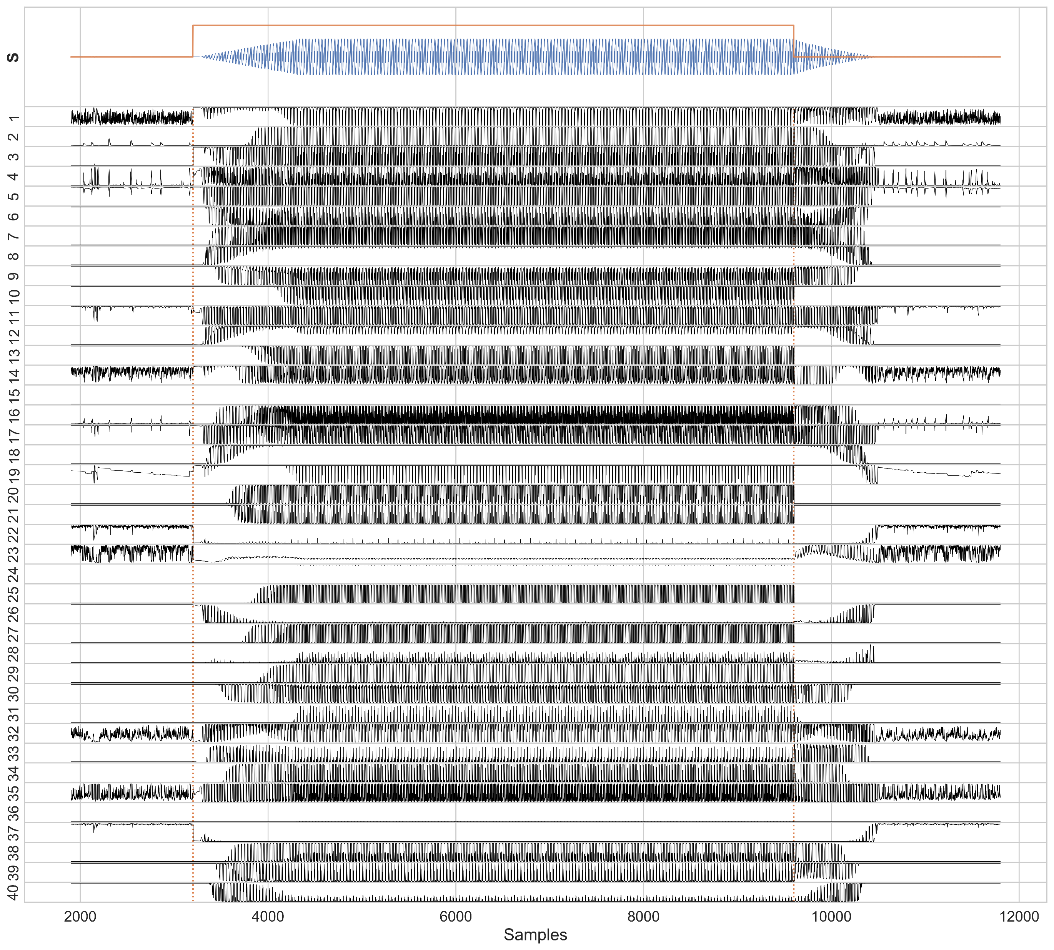
Hidden layer patterns - transients
Volume selectivity patterns are still visible during transients in the same units as before
Asymmetry in unit response between attack and decay
Notes:
Step the volume up, maintain for a period of time then drop the volume back to zero – attack and decay transients form
Selectivity patterns similar to the ones shown previously still observed (mention 10,39,40 again)
Interesting asymmetric pattern the hidden unit responses between the attack and decay portions. Several unit immediately switch off (tracking the volume parameter instead of the actual amplitude of the output signal). E.g. 10,13,20,25
Unfortunately we do not have a concrete explanation for this disparity yet, warrants further investigation. What is breaking the symmetry?

Slide 16
Future work
Training data from physical models / real instruments
Use of embeddings to interpolate instruments
Improve robustness of model
Notes:
I would like to end off with a note on the future direction of this project…
Train on more complex, noisy signals -> immediate step physical models (has the advantage of in built parameters for us to use) -> want to eventually move to real instrument data for a richer sound
Want to increase the number of instruments beyond 2. To navigate the timbre space in a principled manner we take inspiration from prior work in timbre spaces and Google’s Magenta group with nsynth and learn an embedding. Use this to condition the model
Improve general robustness -> may need to increase size, find alternative architectures

Slide 17
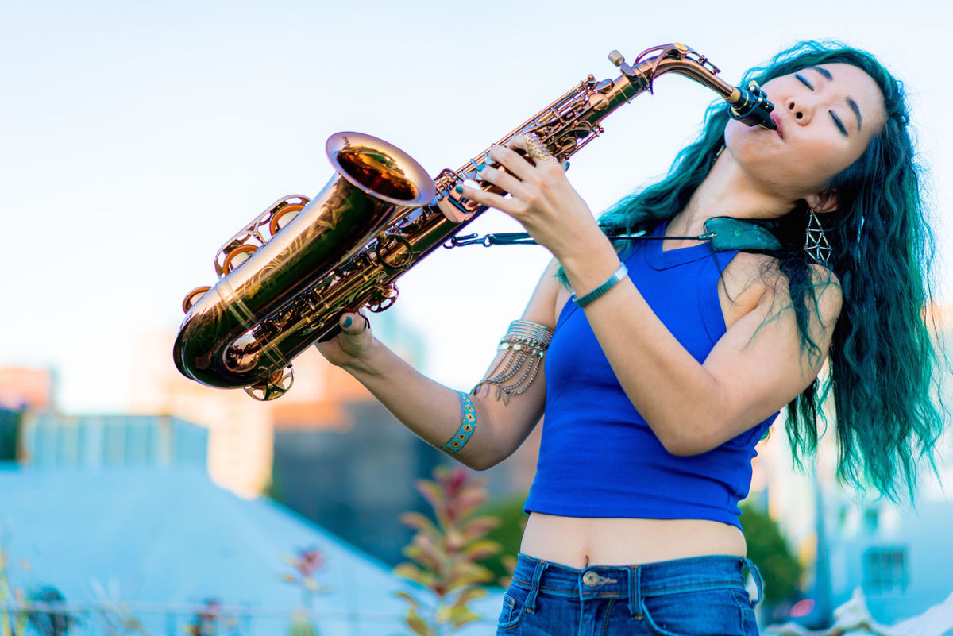
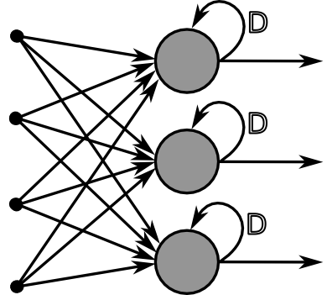
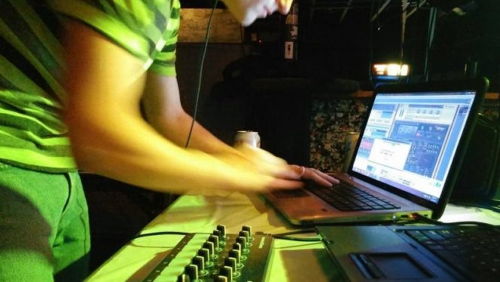
Thank you
Please contact us for
Post Doc and PhD funding opportunities

Slide 18
Links to paper: http://smc2019.uma.es/articles/S8/S8_01_SMC2019_paper.pdf
Github: https://github.com/muhdhuz

Slide 19
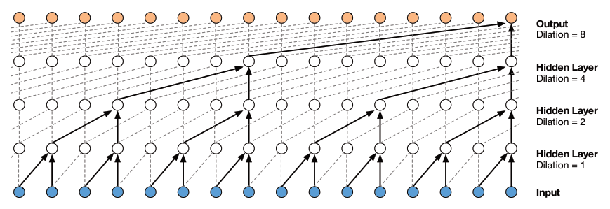
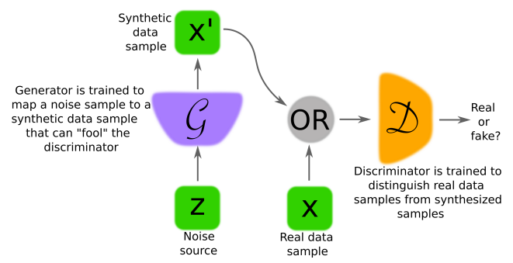
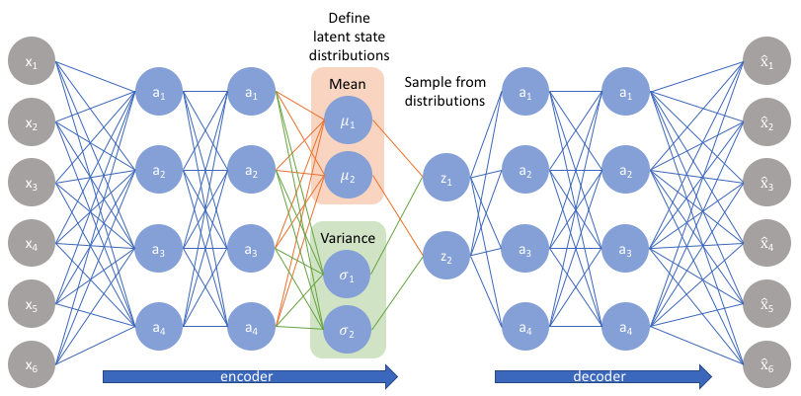
Methodology 1 - Model
DEEP NEURAL NETWORKS
Challenge: To preserve local fidelity while capturing long-term (temporal) correlations
A variety of generative architectures are suitable
GANs
Autoregressive
VAEs

